Slide 1
Chapter 10
Practical Database Design Methodology and Use of UML Diagrams

Slide 2
Chapter 10 Outline
The Role of Information Systems in Organizations
The Database Design
and Implementation Process
Use of UML Diagrams as an Aid to Database Design Specification
Rational Rose: A UML-Based Design Tool
Automated Database Design Tools

Slide 3
Practical Database Design
Methodology and Use of UML Diagrams
Design methodology
  Target database managed by some type of database management system
Various design methodologies
Large database
  Several dozen gigabytes of data and a schema with more than 30 or 40 distinct entity types

Slide 4
The Role of Information Systems in Organizations
Organizational context for using database systems
  Organizations have created the position of database administrator (DBA) and database administration departments
  Information technology (IT) and information resource management (IRM) departments
    Key to successful business management

Slide 5
The Role of Information Systems in Organizations (cont’d.)
  Database systems are integral components in computer-based information systems
  Personal computers and database system-like software products
    Utilized by users who previously belonged to the category of casual and occasional database users
  Personal databases gaining popularity
  Databases are distributed over multiple computer systems
    Better local control and faster local processing

Slide 6
The Role of Information Systems in Organizations (cont’d.)
  Data dictionary systems or information repositories
    Mini DBMSs
    Manage meta-data
  High-performance transaction processing systems require around-the-clock nonstop operation
    Performance is critical

Slide 7
The Information System Life Cycle
Information system (IS)
  Resources involved in collection, management, use, and dissemination of information resources of organization

Slide 8
The Information System Life Cycle
Macro life cycle
  Feasibility analysis
  Requirements collection and analysis
  Design
  Implementation
  Validation and acceptance testing
  Requirements collection and analysis

Slide 9
The Information System Life Cycle (cont’d.)
The database application system life cycle: micro life cycle
  System definition
  Database design
  Database implementation
  Loading or data conversion

Slide 10
The Information System Life Cycle (cont’d.)
  Application conversion
  Testing and validation
  Operation
  Monitoring and maintenance

Slide 11
The Database Design and Implementation Process
Design logical and physical structure of one or more databases
  Accommodate the information needs of the users in an organization for a defined set of applications
Goals of database design
  Very hard to accomplish and measure
Often begins with informal and incomplete requirements

Slide 12
The Database Design and Implementation Process (cont’d.)
Main phases of the overall database design and implementation process:
  1. Requirements collection and analysis
  2. Conceptual database design
  3. Choice of a DBMS
  4. Data model mapping (also called logical database design)
  5. Physical database design
  6. Database system implementation and tuning

Slide 13
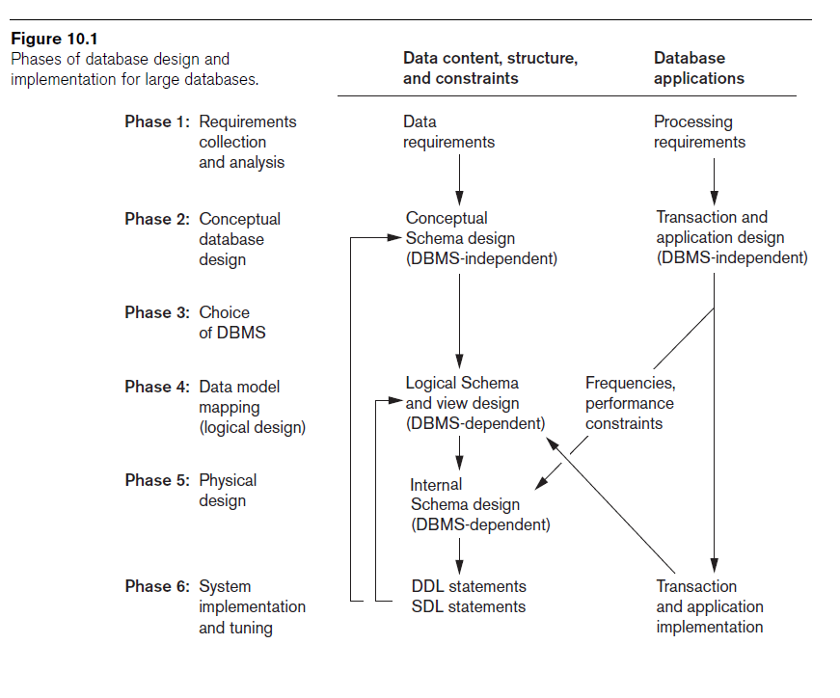

Slide 14
The Database Design and Implementation Process (cont’d.)
Parallel activities
  Data content, structure, and constraints of the database
  Design of database applications
Data-driven versus process-driven design
Feedback loops among phases and within phases are common

Slide 15
The Database Design and Implementation Process (cont’d.)
Heart of the database design process
  Conceptual database design (Phase 2)
  Data model mapping (Phase 4)
  Physical database design (Phase 5)
  Database system implementation and tuning (Phase 6)

Slide 16
Phase 1: Requirements Collection and Analysis
Activities
  Identify application areas and user groups
  Study and analyze documentation
  Study current operating environment
  Collect written responses from users

Slide 17
Phase 1 (cont’d.)
Requirements specification techniques
  Oriented analysis (OOA)
  Data flow diagrams (DFDs
  Refinement of application goals
  Computer-aided

Slide 18
Phase 2: Conceptual Database Design
Phase 2a: Conceptual Schema Design
  Important to use a conceptual high-level data model
  Approaches to conceptual schema design
    Centralized (or one shot) schema design approach
    View integration approach

Slide 19
Phase 2: (cont’d.)
  Strategies for schema design
    Top-down strategy
    Bottom-up strategy
    Inside-out strategy
    Mixed strategy
  Schema (view) integration
    Identify correspondences/conflicts among schemas:
      Naming conflicts, type conflicts, domain (value set) conflicts, conflicts among constraints
    Modify views to conform to one another
    Merge of views and restructure

Slide 20
Phase 2: (cont’d.)
  Strategies for the view integration process
    Binary ladder integration
    N-ary integration
    Binary balanced strategy
    Mixed strategy
Phase 2b: Transaction Design
  In parallel with Phase 2a
  Specify transactions at a conceptual level
  Identify input/output and functional behavior
  Notation for specifying processes

Slide 21
Phase 3: Choice of a DBMS
Costs to consider
  Software acquisition cost
  Maintenance cost
  Hardware acquisition cost
  Database creation and conversion cost
  Personnel cost
  Training cost
  Operating cost
Consider DBMS portability among different types of hardware

Slide 22
Phase 4: Data Model Mapping
(Logical Database Design)
Create a conceptual schema and external schemas
  In data model of selected DBMS
Stages
  System-independent mapping
  Tailoring schemas to a specific DBMS

Slide 23
Phase 5: Physical Database Design
Choose specific file storage structures and access paths for the database files
  Achieve good performance
Criteria used to guide choice of physical database design options:
  Response time
  Space utilization
  Transaction throughput

Slide 24
Phase 6: Database System Implementation and Tuning
Typically responsibility of the DBA
  Compose DDL
  Load database
  Convert data from earlier systems
Database programs implemented by application programmers
Most systems include monitoring utility to collect performance statistics

Slide 25
Use of UML Diagrams as an Aid to Database Design Specification
Use UML as a design specification standard
Unified Modeling Language (UML) approach
  Combines commonly accepted concepts from many object-oriented (O-O) methods and methodologies
  Includes use case diagrams, sequence diagrams, and statechart diagrams

Slide 26
UML for Database Application Design
Advantages of UML
  Resulting models can be used to design relational, object-oriented, or object-relational databases
  Brings traditional database modelers, analysts, and designers together with software application developers

Slide 27
Different Types of Diagrams in UML
Structural diagrams
  Class diagrams and package diagrams
  Object diagrams
  Component diagrams
  Deployment diagrams

Slide 28
Different Types of Diagrams in UML (cont’d.)
Behavioral diagrams
  Use case diagrams
  Sequence diagrams
  Collaboration diagrams
  Statechart diagrams
  Activity diagrams

Slide 29
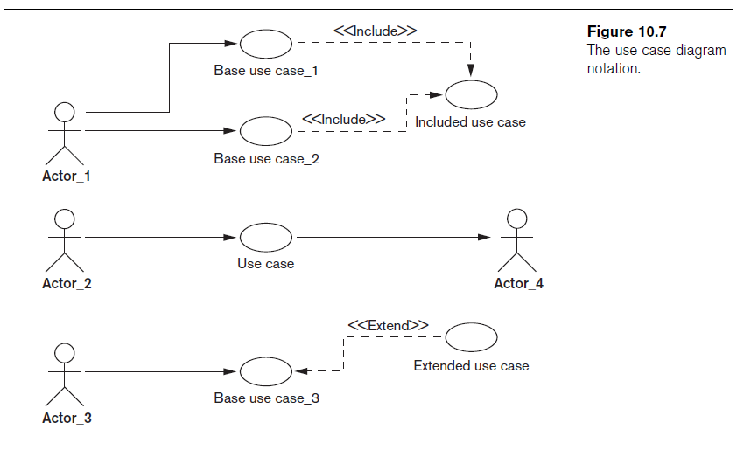

Slide 30
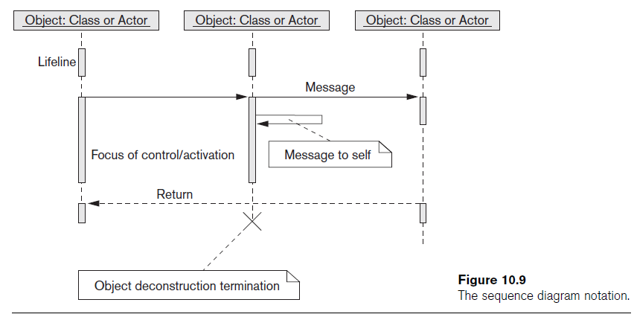
Different Types of Diagrams in UML (cont’d.)

Slide 31
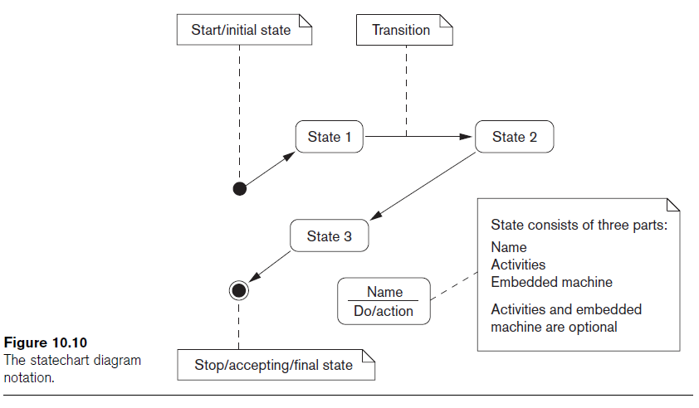
Different Types of Diagrams in UML (cont’d.)

Slide 32
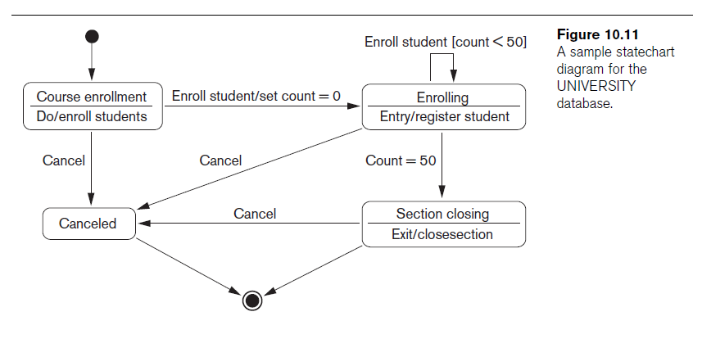
Modeling and Design Example: UNIVERSITY Database

Slide 33
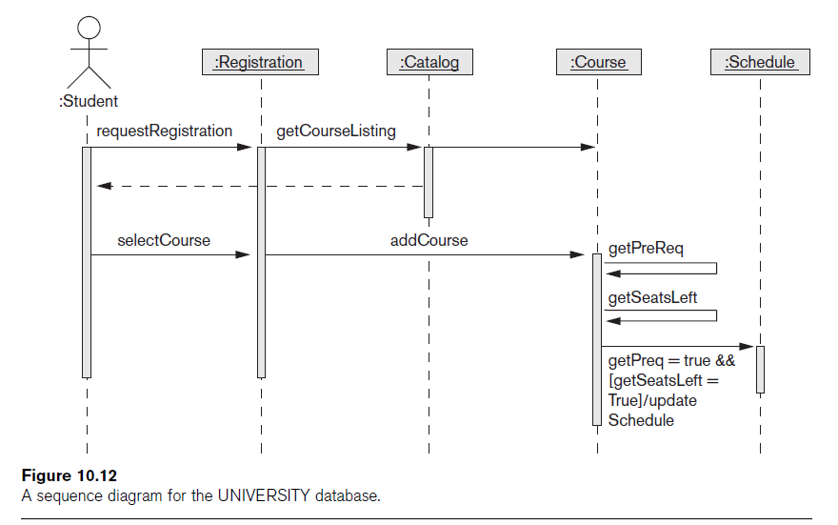

Slide 34
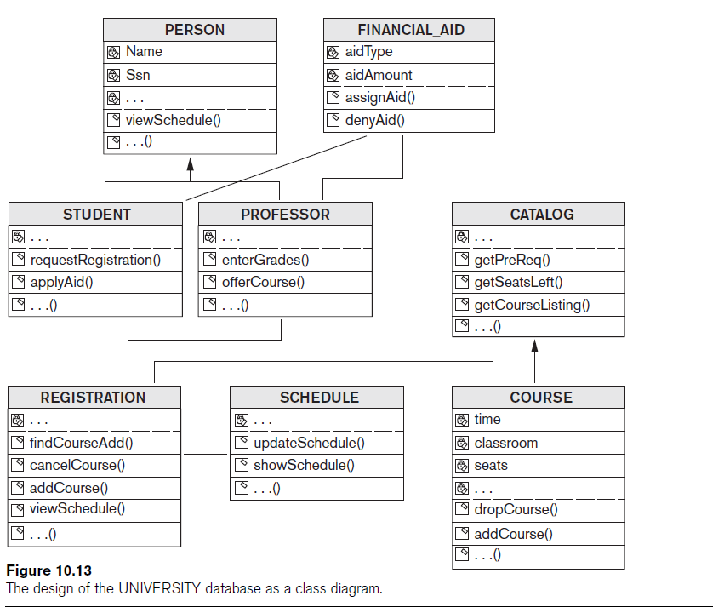

Slide 35
Rational Rose: A UML-Based Design Tool
Rational Rose for database design
  Modeling tool used in the industry to develop information systems
Rational Rose data modeler
  Visual modeling tool for designing databases
  Provides capability to:
    Forward engineer a database
    Reverse engineer an existing implemented database into conceptual design

Slide 36
Data Modeling Using Rational Rose Data Modeler
Reverse engineering
  Allows the user to create a conceptual data model based on an existing database schema specified in a DDL file
Forward engineering and DDL generation
  Create a data model directly from scratch in Rose
  Generate DDL for a specific DBMS

Slide 37
Data Modeling Using Rational Rose Data Modeler (cont’d.)
Conceptual design in UML notation
  Build ER diagrams using class diagrams in Rational Rose
  Identifying relationships
    Object in a child class cannot exist without a corresponding parent object
  Non-identifying relationships
    Specify a regular association (relationship) between two independent classes

Slide 38
Data Modeling Using Rational Rose Data Modeler (cont’d.)
Converting logical data model to object model and vice versa
  Logical data model can be converted to an object model
  Allows a deep understanding of relationships between conceptual and implementation models

Slide 39
Data Modeling Using Rational Rose Data Modeler (cont’d.)
Synchronization between the conceptual design and the actual database
Extensive domain support
  Create a standard set of user-defined data types
Easy communication among design teams
  Application developer can access both the object and data models

Slide 40
Automated Database Design Tools
Many CASE (computer-aided software engineering) tools for database design
Combination of the following facilities
  Diagramming
  Model mapping
  Design normalization

Slide 41
Automated Database Design Tools (cont’d.)
Characteristics that a good design tool should possess:
  Easy-to-use interface
  Analytical components
  Heuristic components
  Trade-off analysis
  Display of design results
  Design verification

Slide 42
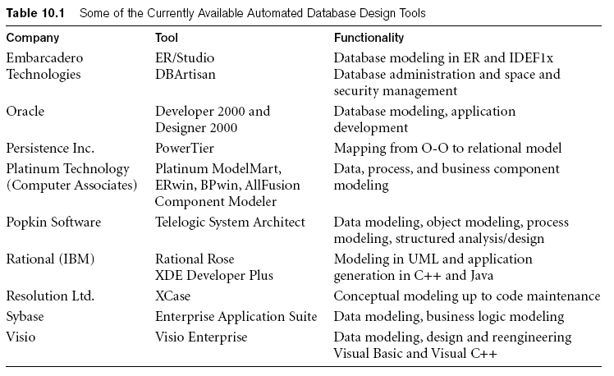
Automated Database Design Tools (cont’d.)
Variety of products available
  Some use expert system technology

Slide 43
Summary
Six phases of the design process
  Commonly include conceptual design, logical design (data model mapping), physical design
UML diagrams
  Aid specification of database models and design
Rational Rose and the Rose Data Modeler
  Provide support for the conceptual design and logical design phases of database design

